Slide 1
How to Review a Paper
Ewa Kittel-Prejs
Elsevier Journals Publishing Director Eastern Europe Moscow, September 24-26th 2013

Slide 2
Opening Question
Why is peer review a part of the scholarly publishing process?
Notes:
Thought question to initiate audience participation and gauge their understanding of what peer review is and what function it performs.

Slide 3
Objectives
What is the history of peer review and what role does it serve?
Why should I consider being a reviewer?
How do I carry out a proper and thorough review?
Notes:
3 major sections of the presentation are geared towards answering these 3 questions.
1. What is the history of peer review and what role does it serve?
2. Why should I consider being a reviewer?
3. How do I carry out a proper and thorough review?

Slide 4
What is the history of peer review and what role does it serve?
Notes:
Section Title Slide

Slide 5
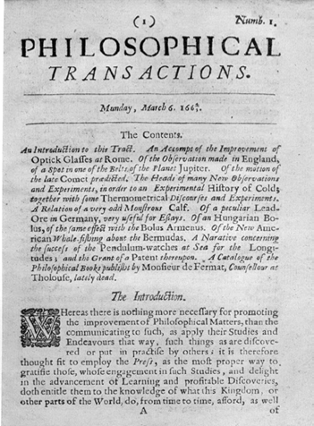
Background on Peer Review
Cornerstone of the whole scholarly publication system
Maintains integrity in the advancement of science
Well-established process over 300 years old
Notes:
1. Peer review serves as a lynchpin or cornerstone of the scholarly publication system. This is because it effectively subjects an author’s work to the scrutiny of other experts in the field. Thus, it encourages authors to strive for a high quality of research that will advance the field.
2. It supports and maintains integrity and quality in the advancement of science. It is a testament to the power of peer review that a scientific hypothesis or statement presented to the world is largely ignored by the scholarly community unless it is first published in a peer-reviewed journal. We see this further supported by the fact that ISI considers only journals that are peer-reviewed as candidates to receive Impact Factors.
3. It is a well established process which has been a formal part of scientific communication for over 300 years.
The Philosophical Transactions of the Royal Society (1665) is credited as being the first journal to formalize the peer review process as the Council of the Society reviewed papers and approved their being printed in each issue.

Slide 6
What is Peer Review?
Peer Review has two key functions:
Acts as a filter by ensuring only good research is published. Helps to determine validity, significance and originality
Improves the quality of the research submitted for publication by giving reviewers the opportunity to suggest improvements
Reviewers
Pre-Submission
Peer Review
Editor
Authors
Post Publication
Production
Publication
Notes:
The diagram to the right shows how peer review is a vital component of the publication process that starts with authors submitting papers. The editors manage this cycle and relay suitable manuscripts to the reviewers to conduct the peer review.
The peer review serves two purposes. The first is to act as a filter to ensure that good, high-quality research is being published. In doing so it helps to determine the validity, significance and originality of research
The second purpose is to improve the quality of the research papers. This is done through the comments the reviewers send to the authors.

Slide 7
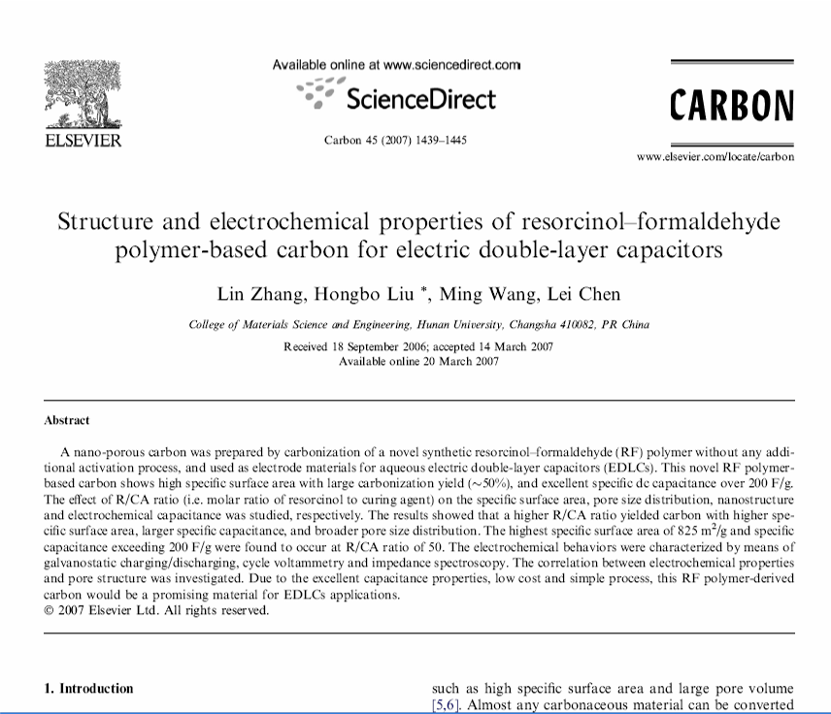
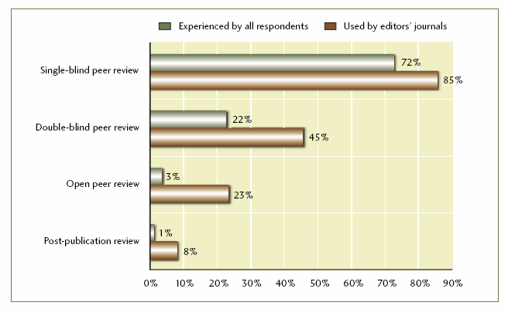
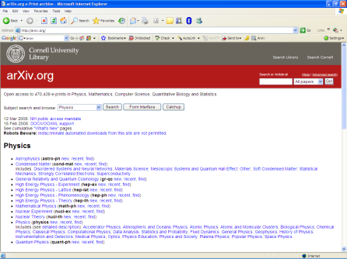
Different Types of Peer Review
POST-PUBLICATION
“Single blind” peer review
“Double blind” peer review
Open peer review
Experimental
Post-publication peer review
Dynamic peer review
PRE-PRINT
NOT DISCLOSED
Comments:
“………” 5 star rating
“………” 3.5 star rating
Etc.
“ And the reviewer is… ”
www.naboj.com
Publishing Research Consortium
Notes:
It may be worthwhile to note that there are different forms or types of peer review in existence.
The first type is the most traditional and most common. It is “single blind” peer review, where the reviewer is anonymous to the author and reviewer does not receive credit explicitly. The author, however, is known to the reviewer. Again, the large majority of journals employ this type of peer review and the main benefit is that the reviewer can comment on the paper without worrying about repercussions.
The second type is “double blind” peer review where the author is made anonymous to the reviewer as well. This is rarely employed, although the argument is that this prevents potential reviewer bias and provides for a more fair review. In the PRC study, 45% of authors said they had experience of double blind peer review.
In “open peer review”, the reviewers’ comments (and sometimes their names) are made public (or just to the authors). But, their contribution gets acknowledged. E.g. British Medical Journal, Biomed Central journals, PLoS Medicine. There is uncertain success of this system. A pilot project conducted by Nature in 2006 found that there was little uptake by authors when given the option to undergo open peer review. And only 54% of eligible articles received public comment after publication. In the PRC study, only 23% of authors had experience of open peer review.
In a study by the Publishing Research Consortium, “Peer Review: benefits, perceptions, and alternatives”, single and double blind peer review are the two most widely used and predominate. Open peer review is being used regularly for some journals as well, but not to the extent of the first two.
These next two examples are more experimental forms of peer review and as of yet serve more as useful additions but not replacements for the more widely accepted forms of peer review.
Post-publication peer review is a fundamentally different form of manuscript development. In this case, all articles are published and then the public reviews them afterwards. Philica is a journal launched with this experimental form of peer review.
In “dynamic peer review”, users are allowed to peer review preprints on repositories (for instance if this was a physics preprint, it could be reviewed on ArXiv with the Naboj tool). This allows the public to see both the article and the reviews as the article is being developed.
The point is that the alternative forms of peer review are still unestablished and experimental. Traditional peer review is time-tested and still highly utilized. All of these types of peer review have their advantages and deficiencies and all are prone to error.

Slide 8
Who conducts reviews and why do they do it?
Notes:
Section Title Slide

Slide 9
Who Conducts Reviews?
Scientific experts in specific fields and topics
Young, old, and mid-career
Average number of completed reviews is 8 per year*
* “Peer Review in Scholarly Journals – perspective on the scholarly community: an international study”. M Ware and M Monkman. Publishing Research Consortium
Notes:
In terms of who reviewers are, they can be anyone who has a competence and expertise in the subject areas that the journal covers.
Reviewers can range from young and up-and-coming researchers, to old masters in the field. Often times the young reviewer is the most responsive and delivers the best quality, but there is not a norm.
The average number of reviews conducted in a year per reviewer is 8 according to a study on peer review by the Publishing Research Consortium. http://www.publishingresearch.org.uk/

Slide 10
Why Do Reviewers Review?
Fulfill an academic ‘duty’
Keep up-to-date with latest developments
Helps with their own research
Build associations with prestigious journals and editors
Remain aware of new research
Develop one’s career
Contribute to the advancement of science
Notes:
Why do reviewers review? They are typically not paid for these services and it is a considerable effort to review a paper. So, what incentives are there for them?
1. Some feel an academic duty to perform reviews (if I expect others to review my papers, then I need to review some myself). Reviewers may also have personal contact with editors and may want to help them out as much as possible.
2. Others want to keep up-to-date with the latest developments in one’s field
3. Others use it as an opportunity to help with their own research by stimulating new ideas.
4. Build associations with prestigious journals and editors and become part of the community. Sometimes, reviewers who show dedication to the journal later become editors.
5. You can be aware of the latest and newest research before your peers.
6. In terms of career development, reviewing activities can be desirable as they are often noted on one’s resume/CV. Reviewing can be an effective way for you to show to your superiors that you are committed to the scientific field.

Slide 11
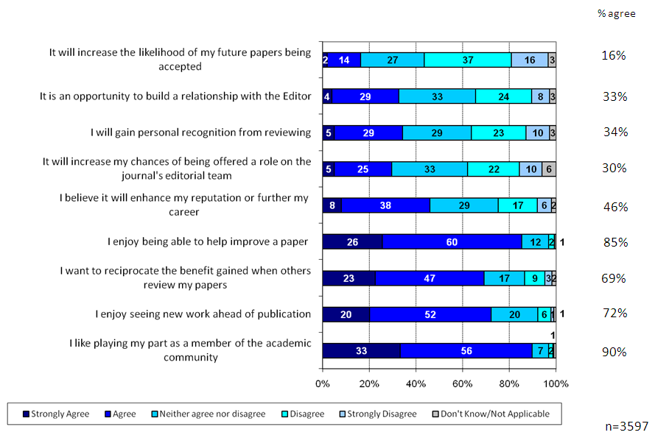
Reasons for Reviewing
(Peer Review Survey 2009)

Slide 12
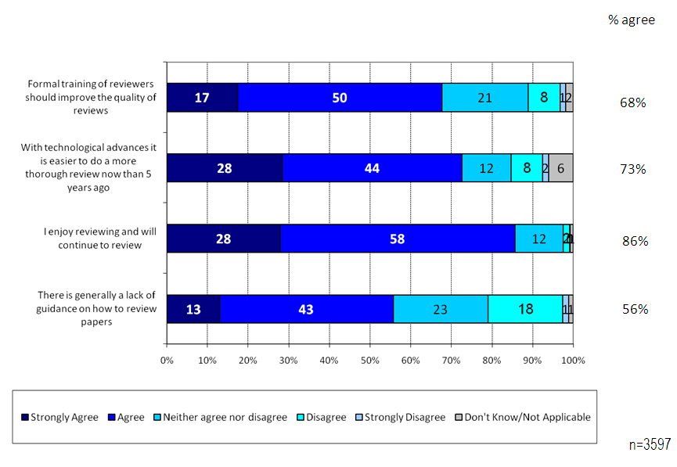
Reviewing Generally
(Peer Review Survey 2009)

Slide 13
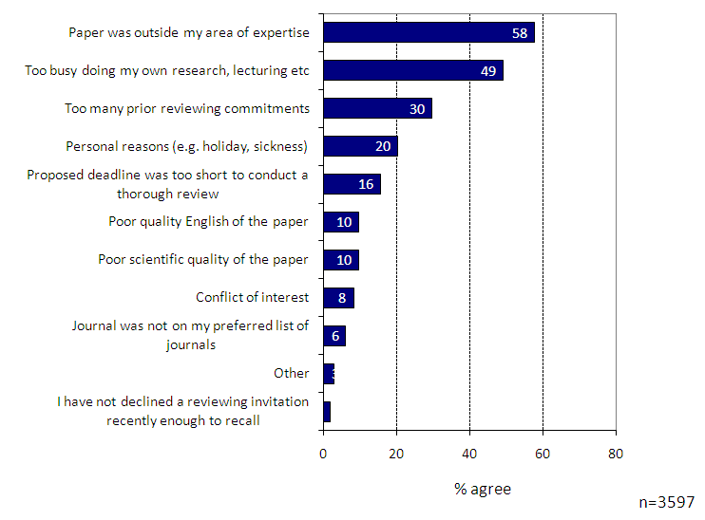
Reasons for Declining to Review
(Peer Review Survey 2009)

Slide 14
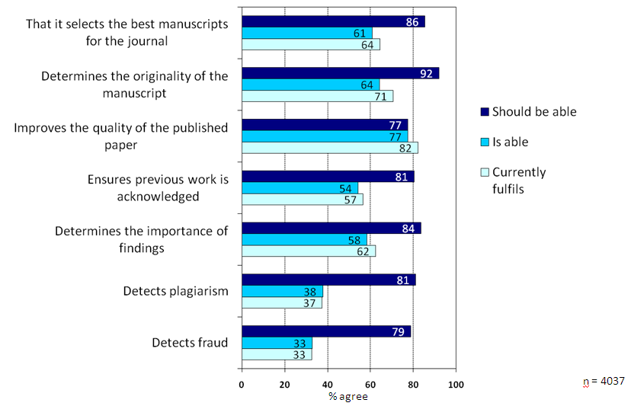
Purpose of Peer Review
(Peer Review Survey 2009)

Slide 15
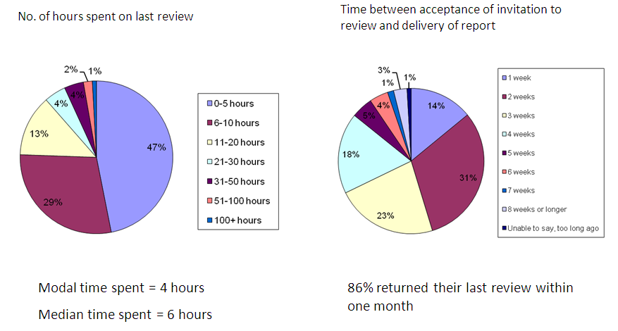
Time taken to review
(Peer Review Survey 2009)

Slide 16
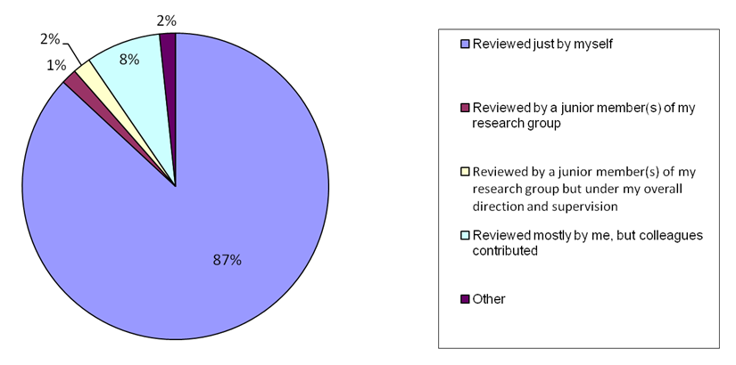
Collaboration during Review
(Peer Review Survey 2009)

Slide 17
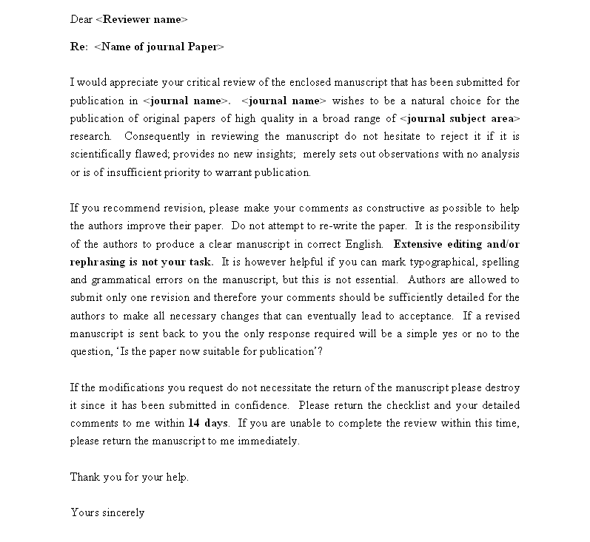
Considerations upon being asked to review
Sample invitation to review
Expertise/ competence to review the article
Necessary amount of time
Reviewing can be time consuming
Deadline stipulated by Editor may be soon
Conflicts of Interest
Examples:
if you work in the same department or institute as one of the authors
worked on a paper previously with an author
have a professional or financial connection to the article
Invitation to review and mission of the journal
Specific reviewing instructions
Stipulated deadline
Notes:
Typically, an editor that sends a paper for review will send an invitation to 2 reviewers. If you happen to receive such an invitation, you are not obligated to accept the invitation. It is necessary to politely and immediately reply to the editor if you decline the invitation. It may even be helpful to recommend another person who may be fit to review the article. Ignoring a request can upset editors and may mean that you are never invited to review in the future. Some important items that you may want to consider in deciding whether or not to accept include:
1. Only accept an invitation if you are competent to review the article. The Editor who has approached you may only be aware of your work in a broader context and may not know your specific areas of expertise.
2. Consider whether you have the necessary amount of time to conduct a thorough and quality review. Reviewing an article can be quite time consuming. The time taken to review can vary from field to field, but an article will take, on average, 3 hours to review properly. Depending on the journal, editors may implement quick and strict deadlines. 2-3 weeks is a typical timeframe. If you cannot conduct the review let the editor know immediately. The Editor will probably appreciate you offering suitable alternative names.
3. Are there any potential conflicts of interest? A conflict of interest will not necessarily eliminate you from reviewing an article, but full disclosure to the editor will allow them to make an informed decision.
Three possible examples of conflict include:
1) if you work in the same department or institute as one of the authors
2) if you have worked on a paper previously with an author
3) if you have a financial or professional interest in the article
This generic invitation to review letter shows you what one can expect. The journal’s mission is clearly set out. What you are asked to evaluate and look for are also established. This is also a good time to point out how the reviewer is NOT expected to overly analyze grammatical errors. The bold statement says, “Extensive editing and rephrasing is not your task.” Grammar mistakes can be noted, but they are not essential. In the last paragraph, the deadline for the review is stipulated.
[Note to presenter: If a comes up about whether or not the underlying data is to be reviewed, you can note that: the reviewer is not expected to review the underlying data. If the data is available, the reviewer may certainly analyze it critically if he/she so chooses.]

Slide 18
How do I carry out a proper and thorough review?
Notes:
Section Title Slide

Slide 19
Overview of Peer Review Process
Article Submitted
Article sent to Publisher
Possible reviewer recommendations
Rejected due to poor quality of research, major flaws in the paper, or out of scope
Accept without revision
Accept, but needs revision either:
Minor
Major
Confirmation of Receipt
Revision Checked
Initial Decision by Editor
Revision Received
Reject
Decide to Review
Revise
Accept
Reviewers Assigned
Notification to Author
Reviewers Accept Invite
Revise
Accept
Reviews Completed
Reject
Notes:
It is important to understand how the reviewer’s efforts fit in with the roles of the author and editor in the peer review process. The reviewer usually communicates 3 possible recommendations when he submits his/her review to the editor.
Rejection due to poor quality or wrong scope
Accepted without revision
Accepted upon either major or minor revision. If you think the article needs to be revised indicate to the editor whether or not you would be happy to review the revised article.
This flowchart shows how the reviewer’s recommendation fits into the larger peer review process. Here we can see all the major actions taken by the author, editor, and reviewer. The green boxes, associated with the reviewer, show how he/she plays a key role in determining whether or not a manuscript is accepted for publication.

Slide 20
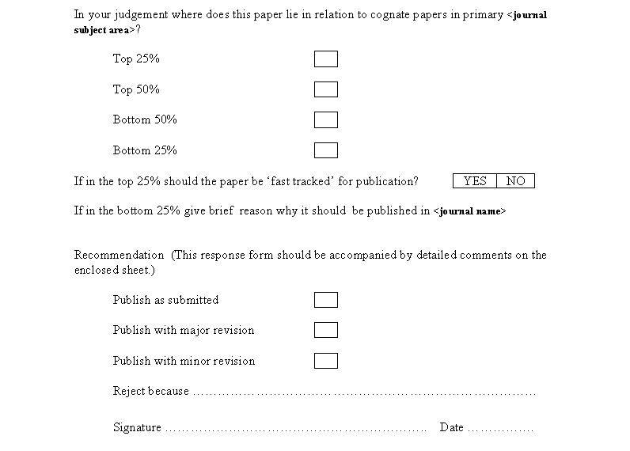
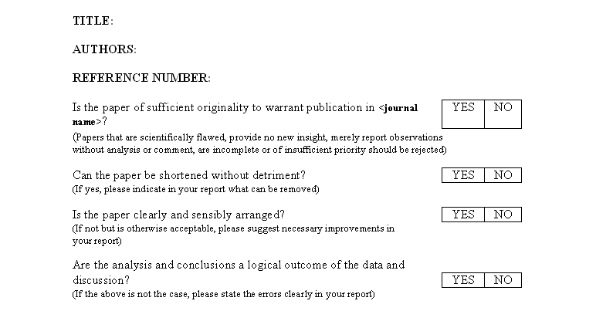
Conducting the Review – General Points
Contact your Editor if you have questions
Maintain confidentiality
Your recommendations will help Editor make the final decision
Set aside ample time to conduct the review
Provide constructive remarks
Typical evaluation criteria
1. Originality
2. Structure
3. Previous Research
4. Ethical Issues
Sample Review Form
Evaluation of originality
Detailed comments to be included
Final Recommendation
Assessment of paper’s structure
Notes:
Now that we’ve seen how the peer review process works, here are some general points that one should keep in mind when actually conducting the review itself.
1. If you are in doubt about any aspect of the review process, contact your Editor directly to clarify the situation.
Confidentiality must be maintained in the review. If you wish to elicit opinion from colleagues or students regarding the article you should let the editor know beforehand. It is normally not a problem to do so. Most editors welcome additional comments, but whoever else is involved will likewise need to keep the review process confidential. You should not attempt to contact the author.
Be aware any recommendations or advice you make will contribute to the final decision which is made by the editor.
Set aside two or three hours to conduct the review. It is better to complete the evaluation in one go rather than snatching time here and there. Work within the deadline given by the Editor. The goal of your review is to give the author as quick a response as possible.
Provide constructive remarks that will help the author progress towards a higher-quality paper.
Depending upon the journal, you will be asked to evaluate the article on a number of criteria. Sometimes, the journal’s “Guide for Authors” can provide the proper review criteria. If the Editor has not already evaluated the paper in terms of its aim and scope, then the reviewer might be called upon to do this. Normally, however, you would be expected to evaluate the article according to the following areas which the slides after this will go into more detail:
1. Originality
2. Structure (includes appropriate sections, that clearly support their purpose)
3. Previous Research (is cited)
4. Ethical Issues
Here is the top portion of a general review form that you may have to complete and submit back to the editor. Note that it asks for an assessment of the paper’s originality and structure.
The bottom half of the review form asks the reviewer to place the paper into a percentile bucket relative to other papers and also asks for the final recommendation (with detailed comments to be attached as well!).

Slide 21
Conducting the Review - Originality
Sufficiently novel and interesting to warrant publication?
Adds to the canon of knowledge?
Answers an important research question?
Satisfies the journal’s standards?
Falls in the top 25% of papers in this field?
A literature scan of review articles can help the reviewer determine originality
Notes:
In evaluating the originality of the paper, it is good to ask the following:
1. Is the article sufficiently novel and interesting to warrant publication?
2. Does the article add to the canon of knowledge?
3. Does the article answer an important research question?
4. Does the article satisfy the journal’s standards?
5. In order to determine its originality and appropriateness for the journal it might be helpful to think of the research in terms of what percentile it is in? Is it in the top 25% of papers in this field? [Note: top 25% however is not a specific benchmark for originality nor to accept or reject; cf. the average rejection rate across all journals is 50%]
6. You might wish to do a quick literature search using citation tools, such as Scopus, to see if there are any reviews of the area. A review article will be a suitable source of definitive references to see whether any similar articles have already been published. If the research has been covered previously, pass on references of those works to the editor.

Slide 22
Conducting the Review - Structure
Key sections are included and are laid out clearly
Title
Abstract
Introduction
Methodology
Results
Discussion/ Conclusion
References
Title
Does it clearly describe the article?
Abstract
Does it reflect what was done and what the major findings were?
Introduction
Does it clearly state the problem being investigated and accurately describe what the author hopes to achieve?
Normally, the introduction is one to two paragraphs long.
Does it summarize relevant research to provide context?
Does it explain what findings of others, if any, are being challenged or extended?
Methodology
Does it accurately explain how the data was collected?
Is the design suitable for answering the question posed?
Is there sufficient information present for you to replicate the research?
Does the article identify the procedures followed? Are these ordered in a meaningful way?
If the methods are new, are they explained in detail?
Was the sampling appropriate?
Have the equipment and materials been adequately described?
Does the article make it clear what type of data was recorded; has the author been precise in describing measurements?
Results
Clearly laid out and in a logical sequence?
The appropriate analysis has been conducted?
Are the statistics correct? If you are not comfortable with statistics advise the editor when you submit your report.
If any interpretation has been included in this section – it should not be
Discussion/ Conclusion
Are the claims in this section supported by the results, do they seem reasonable?
Have the authors indicated how the results relate to expectations and to earlier research?
Does the article support or contradict previous theories?
Does the conclusion explain how the research has moved the body of scientific knowledge forward?
References/Previous Research
If the article builds upon previous research does it reference that work appropriately?
Are there any important works that have been omitted?
Are the references accurate?
Notes:
The structure of the paper needs to be reviewed such that all key sections are included and clearly serve their intended purpose. Note that what is considered a necessary or key section is determined by the journal’s “Guide for Authors”. Use that as a suitable reference as needed. [Note to presenter: You may not have enough time or may not want to go through each of the details for each section. Summarize or highlight as necessary.]
1. The title needs to clearly describe the article.
2. The abstract should reflect what was done and what the major findings were.
3. The Introduction Does it clearly state the problem being investigated and accurately describe what the author hopes to achieve?
Normally, the introduction is one to two paragraphs long.
Does it summarize relevant research to provide context?
Does it explain what findings of others, if any, are being challenged or extended?
4. Methods
Does it accurately explain how the data was collected?
Is the design suitable for answering the question posed?
Is there sufficient information present for you to replicate the research?
Does the article identify the procedures followed? Are these ordered in a meaningful way?
If the methods are new, are they explained in detail?
Was the sampling appropriate?
Have the equipment and materials been adequately described?
Does the article make it clear what type of data was recorded; has the author been precise in describing measurements?
5. Results
Clearly laid out and in a logical sequence?
The appropriate analysis has been conducted?
Are the statistics correct? If you are not comfortable with statistics advise the editor when you submit your report.
If any interpretation has been included in this section – it should not be
6. Discussion and Conclusions
Are the claims in this section supported by the results, do they seem reasonable?
Have the authors indicated how the results relate to expectations and to earlier research?
Does the article support or contradict previous theories?
Does the conclusion explain how the research has moved the body of scientific knowledge forward?
7. References/ Previous Research
If the article builds upon previous research does it reference that work appropriately?
Are there any important works that have been omitted?
Are the references accurate?

Slide 23
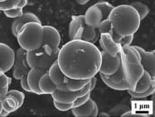
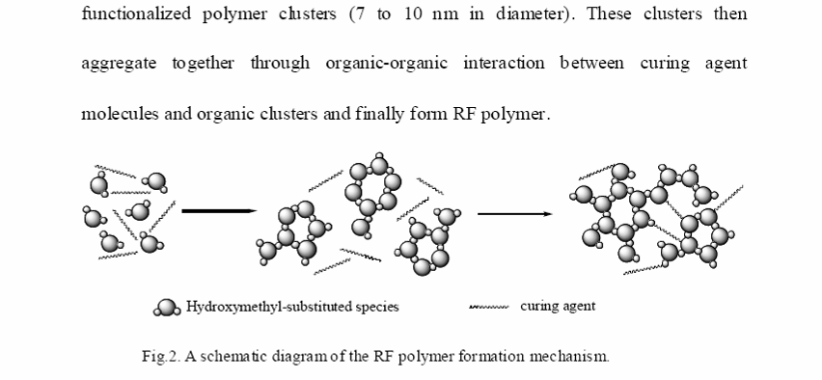
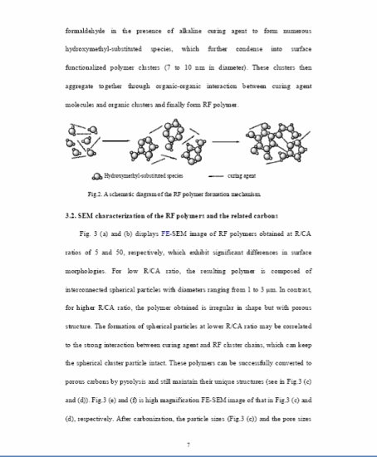
Conducting the Review – Tables & Figures
Relevant and important
Consistency
Color
Caption length and appropriateness
Figures describe the data accurately
Fig.3. FE-SEM images of RFP-50 at 1,0000×
Notes:
Tables and Figures are not be missed and must also be assessed critically by the reviewer:
1. When considering the whole article, do the figures and tables inform the reader and are they an important part of the story?
2. Are the figures consistent with the rest of the presentation?
3. Would it help if the figures were in color?
4. Are the figure titles and captions appropriate? Sometimes authors have long titles and/or include discussion in figure legends or table titles.
5. Do the figures describe the data accurately? Scales on the axes are logical?
Do figures have consistent formatting? (e.g. widths of bars in charts are the same?)
The example shown here is a figure that attempts to describe the aggregation of clusters. It is up to you and audience to decide if the figure describes the concept accurately.

Slide 24
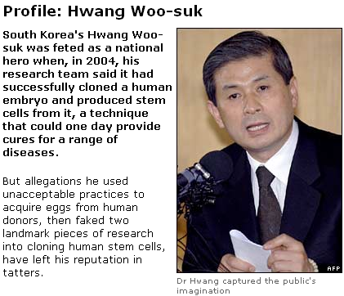
Conducting the Review – Ethical Issues
Plagiarism
Fraud
Medical ethical
concerns
BBC News
Notes:
In terms of ethical issue reviews:
1. Plagiarism takes many forms, from “passing off” another’s paper as the author’s own paper, to copying or paraphrasing substantial parts of another’s paper (without attribution), to claiming results from research conducted by others. If you suspect that an article is a substantial copy of a work/s you are familiar with, let the editor know and be sure to cite the previous work/s.
2. It is very difficult to detect a determined fraudster, but if you suspect that the results in an article are untrue (either through falsified or fabricated data), let the editor know and explain why you believe the results to be fraudulent.
3. If the research is medical in nature, has confidentiality been maintained? Experiments on human subjects or animals should follow related ethical standards, e.g. Helsinki Declaration of 1975, as revised in 2000 (5). If you believe there has been a violation of accepted norms of ethical treatment of animal or human subjects, these should also be identified.
Hwang Woo-suk is the notorious South Korean scientist who was criticized for unacceptable stem cell acquisition practices and then later found to have fabricated almost all of his data for articles on cloning that he had published in top journals.

Slide 25
Review Process (i)
Regular articles are initially reviewed by at least 2 reviewers
When invited, the Reviewer receives the Abstract of the manuscript
The Editor generally requests that the article be reviewed within 2-4 weeks
Limited extensions sometimes acceptable
Articles are revised until acceptance or rejection (in general, until the Editor decides that the Reviewers’ comments have been addressed satisfactorily by the Author)
The Reviewers’ reports provide advice for Editors reach a decision
The Reviewer is the one who recommends; the Editor decides!

Slide 26
Review Process (ii)
If a report has not been received after 4 weeks, the Editorial office contacts the Reviewer
If there is a notable disagreement between the reports of the reviewers, a third Reviewer may be consulted
The anonymity of the reviewers is strictly maintained unless a Reviewer asks to have his/her identity made known to the authors
Januar 2012

Slide 27
Review Process (iii)
As author
Reviewers must not communicate directly with authors
As editor
As reviewer
All manuscripts and supplementary material must be treated confidentially by Editors and Reviewers
The manuscript cannot be distributed outside a small group of people without consultation with an Editor
As reader
The aim is to have a “first decision” to the Authors within 4-6 weeks after submission of the manuscript
Meeting those objectives requires a significant effort on the part of the Editorial staff, Editor and Reviewers
As a researcher, you wear many hats!
If Reviewers treat authors as they themselves would like to be treated as authors, then these objectives can be met

Slide 28
Role of the Reviewer – General impression and Abstract
General impression
Before commenting on parts of the manuscript, add a short summary of the article
Give a general comprehension of the manuscript, its importance, language/style/grammar, and your general level of enthusiasm
Avoid personal remarks or excessive, or pointlessly clever and sarcastic comments:
Reviewer comments are not meant to hurt the authors
If you must be critical, add such remarks to “Comments to Editor”
Abstract
Is it a real summary of the paper?
Including key results?
Not too long?
Long abstracts can be cut off by Abstracting&Indexation Databases such as PubMed

Slide 29
Role of Reviewer: Introduction
Is it effective, clear, and well organized?
Does it really introduce and put into perspective what follows?
But the Introduction should not be a “history lesson”
Suggest changes in organization, and point authors to appropriate citations
Don’t just write “The authors have done a poor job.”

Slide 30
Role of Reviewer: Methods
Can an interested, knowledgeable colleague reproduce the experiments and get “the same” outcomes?
Did the authors include proper references to previously published methodology?
Is the description of new methodology accurate?
Source of solvents or reagents used can be very critical
Could or should the authors have included Supplementary material?

Slide 31
Role of the Reviewer – Results and Discussion (i)
Suggest improvements in the data shown, in presentation, and in style
Comment on general logic, and on justification of interpretations and conclusions
Comment on number of figures, tables, schemes, their need and their quality
Write concisely and precisely which changes you recommend:
Distinguish between “needs to change” and “nice to change”
Keep in mind that the author must be able to respond to your comments, whether it’s implementation or a rebuttal

Slide 32
Role of the Reviewer – Results and Discussion (ii)
List, separately under one header, suggested changes in style, grammar, and other changes you are suggesting
Nowadays such comments can also be made in PDF
Require or suggest other experiments or analyses
Make clear why there is a need for such, but defer to the Editor if you are not sure whether new experiments are essential, or would be more appropriate for future studies
Before you propose additional work, first ask yourself whether the manuscript is worth publishing at all!
January 2012

Slide 33
Role of Reviewer: Conclusions
Comment on importance, validity and generality of conclusions
Request “toning down” unjustified claims and generalizations
Request removal of redundancies and summaries
The Abstract, not the Conclusion summarizes the study

Slide 34
Role of Reviewer: References, Tables, Figures
Check, if possible, accuracy of citations, and also comment on number and appropriateness:
Too many self-citations?
Comment on any footnotes (to text or tables) and whether these should have been included in the body of the text
Comment on need for figures/tables/graphs, their quality, readability
Comment on need for color in figures
Assess legends, captions, headings, and axis labels
Check for consistency of presentation:
language, font, size, etc

Slide 35
Sending Your Report to the Editor
Anticipate the deadline
Summarize the article at the top of your report
The report should be comprehensive
Explain and support your judgments
Make a distinction between your own opinions and your comments based on data
Be courteous and constructive
Notes:
Once your evaluation of the paper is complete, keep the following in mind for filling out the report to the Editor:
1. If it looks like you might miss your deadline, let the editor know.
2. It is helpful to provide a quick summary of the article at the top of your report. It serves a dual purpose:
- reminds the editor of the details of the report
- reassures the author and editor that you understood the article.
3. The report should contain the key elements of your review, addressing the points outlined in the preceding slides.
4. Providing insight into any deficiencies is important. You should explain and support your judgment so that both editors and authors are better able to understand the basis of the comments.
5. You should indicate whether your comments are your own opinion or reflected by data.
6. When providing commentary you should be courteous and constructive, consider, ‘how would you react to receiving your suggestions’. It should not include any personal remarks.

Slide 36
Editors’ View: What makes a good reviewer?
A good Reviewer
‘Provides a thorough and comprehensive report’
‘Provides the report on time!’
‘Provides well-founded comments for author which the Editor can cut-and-paste into the report for the author.’
‘Provides constructive criticism.’
‘Demonstrates objectivity.’
‘Provides a clear recommendation for the Editor which is in agreement with the content of the reviewer report.’

Slide 37
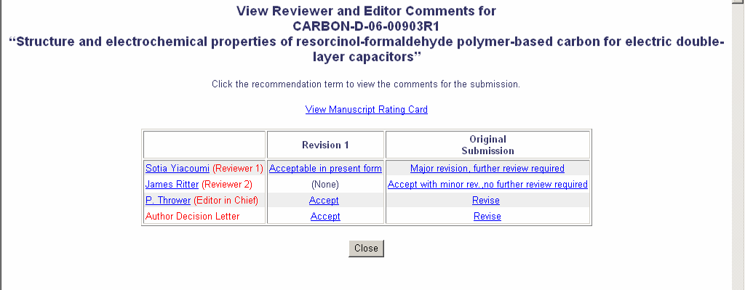
Sample Paper
S. Jacobs (Reviewer 1)
J. Ritman (Reviewer 2)
L. Smith (Editor in Chief)
Author Decision Letter
Notes:
To better illustrate different stages of the review process, here is an actual example of a manuscript that was submitted to the journal, Carbon. Note that in this case, the online Elsevier Editorial System (EES) is being used to manage the peer review process. Many publishers have developed similar online peer review systems. Whether or not you receive and conduct the peer review online or with hard-copies varies according to the journal and the decisions made by the editors.
As you can see here, this paper was originally submitted and both reviewers recommended that the author make revisions. One reviewer suggested major revision, the second suggested minor revisions.
After the authors made the revision to the paper, it was accepted for publication.

Slide 38
Reviewer’s Submission
Notes:
This is a copy of the actual online reviewer’s form that reviewers of this specific journal are asked to fill out. This process varies greatly by journal. Some are done online, through editorial systems provided by publishers. Others use different forms that need to be completed.

Slide 39
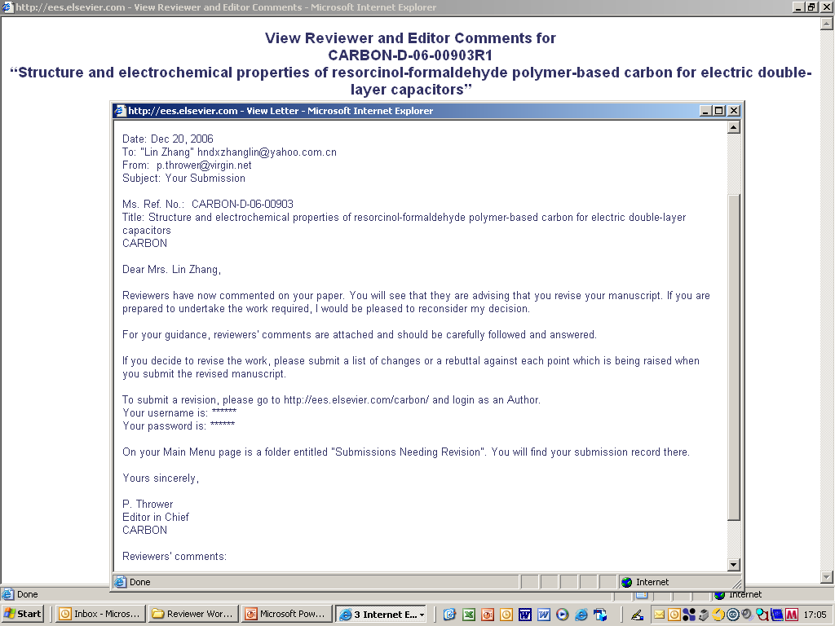
Editor’s Letter to Authors
To: Jones@college.edu
From: Smith@university.edu Subject: Your Submission
Ms. Jones,
Dr. Smith
Notes:
This is the letter that the Editor sent to the Corresponding Author informing him/her that revisions to the manuscript were recommended.

Slide 40
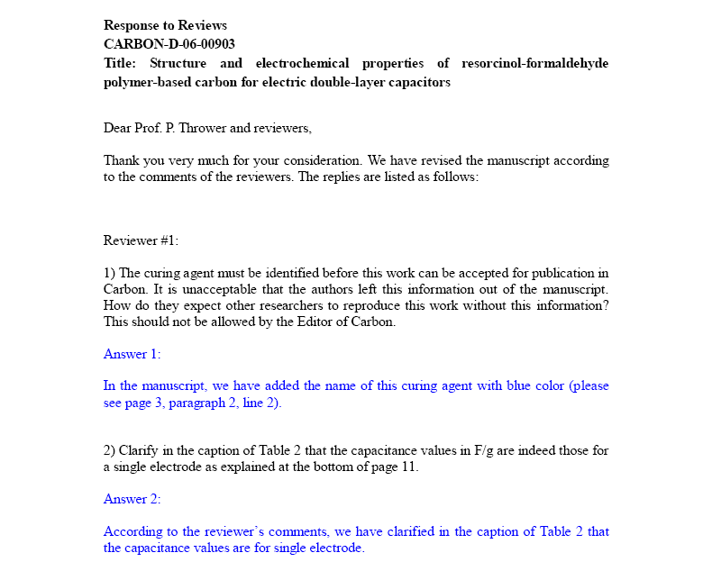
Author’s Revisions to Detailed Comments
Dear Dr. Smith and Reviewers,
Notes:
And here’s the author’s response letter to the Editor and reviewers after having made revisions. Note how the author has responded to each of the detailed comments that the reviewers have provided. This is a good example of the level of detail that is required of a reviewer in providing comments to the author.

Slide 41
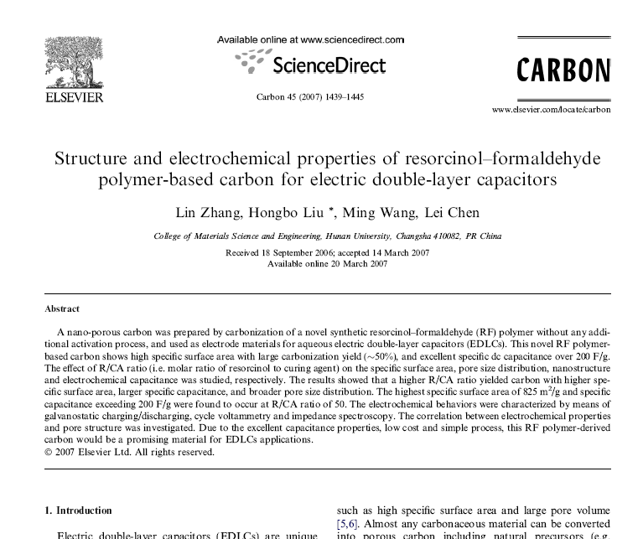
Final Article
A. Jones, Y. Lee, R. Lopez
Southern University, Main Road, UK
Received 18 September 2006; accepted 14 March 2007
Available online 20 March 2007
Notes:
And this is the final article that emerged from that process.

Slide 42
Summary
What is the history of peer review and what role does it serve?
Peer review is the cornerstone of the scholarly publication process
Filters out good research and improves it
Why should I consider being a reviewer?
Reviewing can be a career building activity that also keeps one in touch with the latest research in the field
How do I carry out a proper and thorough review?
Analyze the article for its originality, structure, and ethical sufficiency
Provide detailed, constructive comments and communicate clearly with the Editor
Notes:
Summary, as it reads on the slide.

Slide 43
Thank you.
Questions?
Notes:
Summary, as it reads on the slide.

